Slide 1
Healthcare Insurance Transparency
Presented By: Tin Diep, Yingzhe Geng, Raquel Guerra, Samin Khan, Aye Chan Moe, Rohit Narayanan, Shubham Pathare, and Xiaowen (Sally) Shang
April 15th, 2025

Slide 2
Introduction
The ClearCare Data Initiative
Empower consumers with healthcare cost data
Help people make cost-effective decisions
Notes:
The ClearCare Data Initiative seeks to empower consumers with as much information as possible in order for them to make the most cost-effective healthcare decision

Slide 3
Index
01
02
Objectives
Technical Analysis
03
04
Data Analysis
Summary
Focus Areas and Datasets
Data Collection, Data Cleaning, & Issues
Insights
Next Steps

Slide 4
01
Objectives
Focus Area, and Dataset

Slide 5


New York-Newark-Jersey City, NY-NJ-PA Metropolitan Statistical Area (MSA) vs. Austin-Round Rock-San Marcos Metropolitan Statistical Area (MSA)
vs.
New York MSA
The MSA has a population of 19.8M people
The economy of NY MSA employs 9.73M people
Largest industries: Health Care & Social Assistance (1,603,299 people), Educational Services (1,038,874 people), and Professional, Scientific, & Technical Services (1,020,449 people)
The New York metro area houses approximately 274 hospitals and primary care facilities, including 87 general hospitals.
NYC Health + Hospitals received a top rating for meeting federal hospital price transparency requirements (2021), ranking among the top 1%
Austin MSA
The MSA has a population of 2.36M people
The economy of Austin MSA employs 1.29M people
Largest industries: Professional, Scientific, & Technical Services (189,283 people), Retail Trade (134,373 people), and Health Care & Social Assistance (132,772 people)
The Austin MSA is served by approximately 30 hospitals
Texas lacks price transparency, and several facilities do not comply with federal and state regulations. - However, steps have been taken and hospitals like St. David’s Healthcare provides online access to standard charges and offers prospective service quotes to help patients anticipate potential expenses. ** Texas Hospital Association reports that approximately 75% of Texas hospitals are compliant or mostly compliant with federal price transparency requirements.
Notes:
The largest industries in New York-Newark-Jersey City, NY-NJ-PA are Health Care & Social Assistance (1,603,299 people), Educational Services (1,038,874 people), and Professional, Scientific, & Technical Services (1,020,449 people)
The New York metro area houses approximately 274 hospitals and primary care facilities, including 87 general hospitals.
NYC Health + Hospitals received a top rating for meeting federal hospital price transparency requirements, ranking among the top 1%
The Austin MSA is served by approximately 30 hospitals
Hospitals in the Austin area have taken steps to comply with federal and state price transparency regulations. - EX: St. David’s HealthCare provides online access to standard charges and offers prospective service quotes to help patients anticipate potential expenses. - Texas Hospital Association reports that approximately 75% of Texas hospitals are compliant or mostly compliant with federal price transparency requirements.
Rural and Urban Health:
https://hpi.georgetown.edu/rural/#:~:text=Health%20care%20service%20use%20differs&text=The%20rural%20population%20is%20more,6%20people%20per%20square%20mile.
https://datausa.io/profile/geo/austin-round-rock-tx
https://censusreporter.org/profiles/31000US35620-new-york-newark-jersey-city-ny-nj-metro-area/
https://datausa.io/profile/geo/new-york-newark-jersey-city-ny-nj-pa
https://www.causeiq.com/directory/hospitals-list/new-york-newark-jersey-city-ny-nj-pa-metro/
https://www.nychealthandhospitals.org/pressrelease/in-new-study-nyc-health-hospitals-receives-highest-rating-for-meeting-federal-hospital-price-transparency-requirements/#:~:text=Apr%2021%2C%202023,the%20cost%20of%20health%20care.

Slide 6

New York – New Jersey - Pennsylvania
Here is a list of the hospitals, and their designated location:
New York State (11): Queens
-New York Presbyterian Queens New York -New York Presbyterian: (Columbia University Irving Medical Center, Weill Cornell Medical Center, Allen Hospital, Lower Manhattan Hospital, Westchester, Brooklyn Methodist Hospital, Westchester Behavioral Hospital)
- Newark-Wayne Community Hospital
Yonkers
- Saint Joseph’s Medical Center
New Jersey Metros (4): Newark - Newark Beth Israel Medical Center - University Hospital
- Saint Michael's Medical Center
Jersey City
- Jersey City Medical Center
Pennsylvania Metro (1): Pike County
- Wayne Memorial Hospital

Slide 7

Austin - Round Rock - Georgetown TX
Here is a list of the hospitals, and their designated location:
Austin (8)
- Ascension Seton: Medical Center Austin , Northwest Hospital, Shoal Creek - Dell Children's Medical Center North Campus
-St. David's: North Austin Medical Center, South Austin Medical Center -Heart Hospital of Austin -Texas Children’s Hospital North Austin Campus
Round Rock (3)
-Baylor Scott & White Medical Center -Heart Hospital of Austin
-Ascension Seton Williamson Hospital

Slide 8
02
Technical Analysis
Data Collection, Data Cleaning, and Issues

Slide 9
Tools & Language Used
1
Python
3
Visual Studio Code
- Team member familiar with the language - Clean, readable syntax
- Smart code editing - Great to use with Python
2
Excel
4
Google Colab
- Standardize to csv format - View files in quick way
- Cloud base for better process power
5
OneDrive
- Data consolidation - Project coordination

Slide 10
Data Collection
Data collected from official hospital websites (37 hospitals total)
Raw Data: Common file types: JSON, CSV
File sizes: From 10s of MBs up to 8 GBs
Convert the files and scanned the datasets
Mainly focus on CPT code - other codes are also present in the datasets such as HCPCS, CDM, MS-DRG etc.

Slide 11
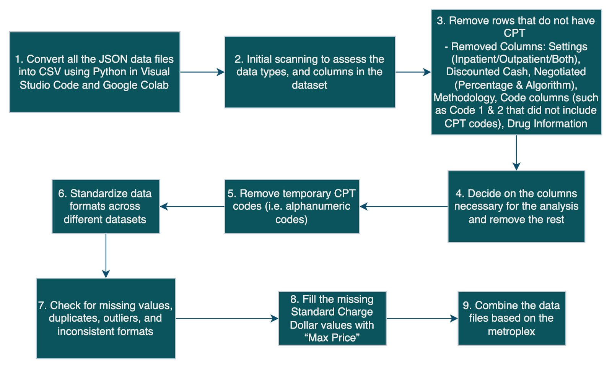
Data Cleaning

Slide 12
Issues
1. Structure difference between .csv versus .json
Chose to standardize data to csv format as it’s most compatible with other tools/programs
Json is hierarchical versus csv is flat
Solution: Used json_normalize()’ function from the Pandas library
2. Data size handling
Some hospital data downloaded were huge but without many useful information.
For example, over hundreds wide format columns, rows with majority blank fields, rows with dummy value ($999,999)
Solution: Split one file into multiple files before data cleaning or replace the hospital data if it contains too much useless fields
Notes:
Early on, we decided to use the CSV file format due to its simple row/column structure as well as compatibility with a myriad of other programs/tools. As such, we converted any JSON files into CSV files.
However, the differing structure of the formats (hierarchical JSON vs. tabular CSV) leads to some tricky work in restructuring JSON data into CSV while maintaining the accuracy of the data. The ‘json_normalize()’ function from the Pandas library is instrumental in flattening the hierarchical data into a tabular one.

Slide 13
Issues -Continued
3. Custom transformations for some unique hospitals
Majority of the hospital data have similar general pattern thus can reuse coding for majority of the hospitals
Time-consuming to clean unique hospital data.
For example, different column for each insurance company’s price, billing codes not consistent, different names for actual charges among hospitals
Solution: Used many Pandas functions from Python library
Notes:
Fortunately, hospital charge data tends to conform (in a general sense) to a standard template, which means code used to refine hospital charge data is mostly repeatable. Thus, while hospitals are unique, custom transformations for the idiosyncrasies of individual hospital charge data are relatively practical.
The primary caveat of the current implementation is that this is only practical at the current scope of the project; the lack of automatic charge data ingestion and transformation severely inhibits the scalability.
Furthermore, some hospitals are more difficult to tame than others. Some hospitals have a unique column for every insurance provider’s charge, others have an inconsistent structure of storing billing codes and code types, and many have unclear fields for the charge itself. Usually, the job is trivial, sometimes it is arduous, but it’s nothing that cannot be fixed by calling lots of pandas functions on the dataframe.

Slide 14
Final Schema
Total Columns Used: 12
Hospital Name
Metroplex: Created column to address the hospitals easier and to combine datasets based on metroplex
State
Zip Code
Billing Code: Only includes CPT codes (5 digits)
Description
*Gross Charge: Charge for procedure that is reflected on hospital's chargemaster
*Max Price: Used for imputing missing values on Insurer Price
*Insurer Price: Renamed column for consistency across datasets stating payer specific negotiated charge (a.k.a Standard Charge Dollar)
Payer Name
Plan Name
Additional Generic Codes: Information that aids in comprehension of the standard charges

Slide 15
03
Initial Data Analysis
Insights

Slide 16
Cost Comparisons
Top 5 most expensive procedure in ascension seton medical center Austin –
93653: A heart procedure that maps and treats fast heart rhythms coming from the upper chambers (like SVT).
93656: A treatment for atrial fibrillation where doctors use energy to fix abnormal signals near the lung veins.
93654: A procedure to treat dangerous fast heartbeats that start in the lower chambers of the heart (like VT).
92937: A heart balloon procedure done during a heart attack to open up blocked arteries.
92924: A special technique to shave off plaque from heart arteries to improve blood flow, sometimes followed by placing a stent. 93653, 93656, 93654 are common across all ascension hospital data we have currently. Top 5 least expensive ascension seton medical center Austin – 83992: A test to check if someone has used PCP (a hallucinogenic drug), using urine or blood.
80377: A detailed drug test that looks for unknown substances in the body.
80323: A test that measures nicotine (from smoking or vaping) in blood or saliva.
80373: A urine test that checks how much tramadol (a painkiller) is in the body.
80188: A blood test to measure levels of primidone, a medicine used to prevent seizures.
Notes:
- Most expensive procedure are cardiovascular (heart) Ascension Seton in Austin—specifically Ascension Seton Medical Center Austin (ASMCA)—does offer specialized cardiac care, including heart surgery

Slide 17
Insurance Comparisons
Most common insurance providers?
Ascension Seton Medical Center Austin
BCBS STAR – 10.6%
AMERIGROUP/WELLPOINT STAR, AMERIGROUP/WELLPOINT STAR PLUS –10.5%
Ascension Seton Northwest Hospital
DELL CHIP – 9.2%
BCBS STAR, AMERIGROUP/WELLPOINT STAR, AMERIGROUP/WELLPOINT STAR PLUS – 9.1%
Ascension Seton Williamson Hospital
DELL CHIP – 9.4%
BCBS STAR, AMERIGROUP/WELLPOINT STAR, AMERIGROUP/WELLPOINT STAR PLUS – 9.3%
Notes:
Ascension Seton is part of Ascension; a nonprofit Catholic health system that has a strong mission focus on serving vulnerable and underserved populations.
Texas has not expanded Medicaid under the Affordable Care Act, there’s a limited pool of providers who accept Medicaid.

Slide 18
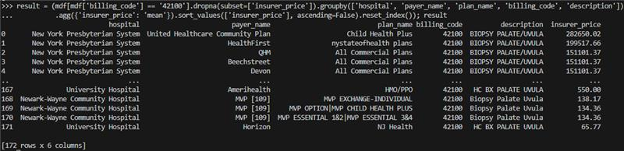
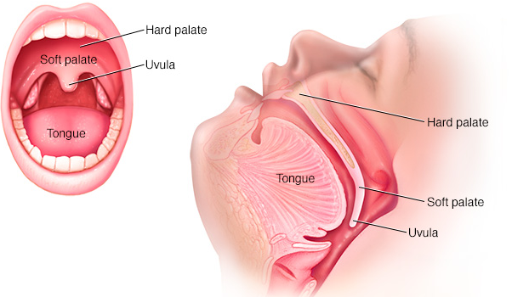
Interesting Finding
Same billing code with extreme cost difference – Example billing code#42100
What’s “biopsy palate/uvula”?
- A procedure where a small tissue sample is removed from the palate (roof of the mouth) or uvula (fleshy, hanging structure at the back of the throat) for examination under a microscope

Slide 19
Interesting Finding - Continued
Why the costs are extremely different? Here are possible reasons regardless of insurance company and plan:
Cost could bundle in OR time, anesthesia, pathology, recovery room, labs, etc
The code is the same, but it doesn't specify what kind of biopsy performed
The charge might be a placeholder, but nobody pays that amount
Hospital type and status different. Higher operating cost or with more complex patients
Different location within the hospital. Same code used in OR vs Outpatient clinic, etc
Hospital location and market dynamics
Input error

Slide 20
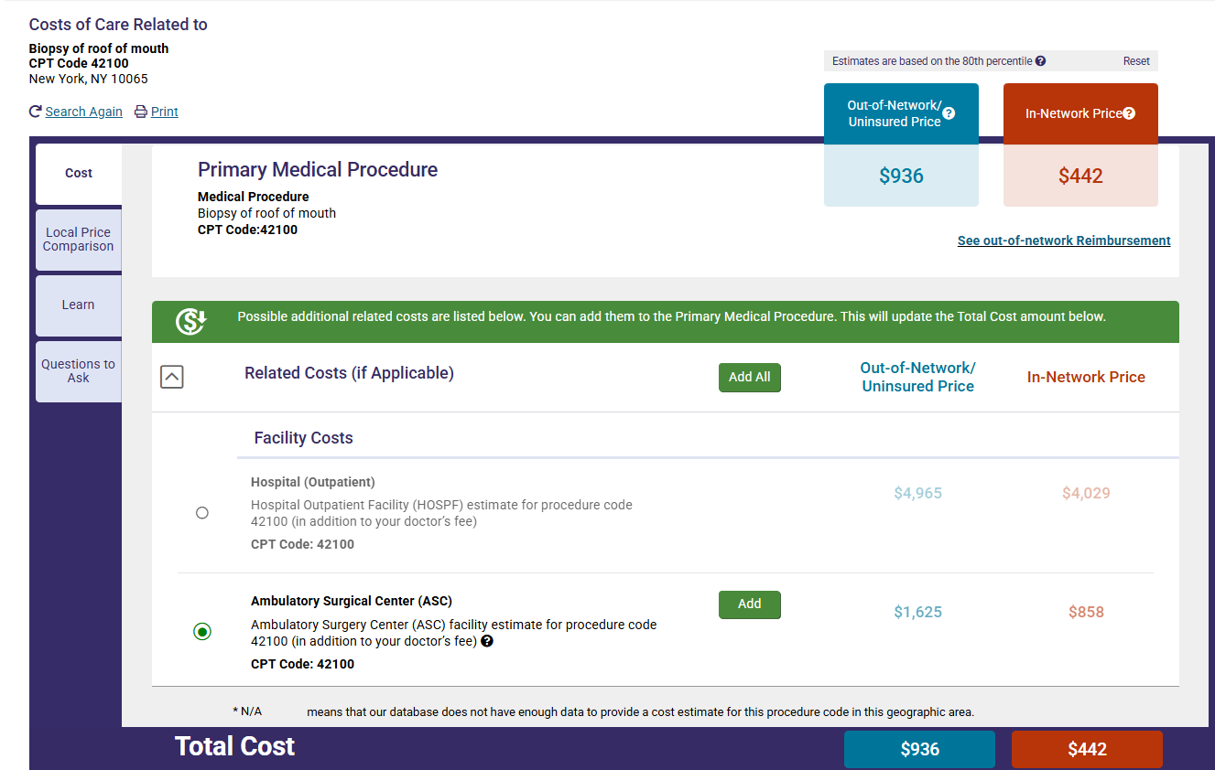
Interesting Finding - Continued
From website FAIR Health about cost of billing code#42100 in New York zip code#10065
Notes:
Link: Biopsy of roof of mouth | FAIR Health

Slide 21
Summary
04
Next steps for the analysis

Slide 22
Summary
NY metro leads in price transparency
Gaps in Texas - Transparency in Austin is less centralized. many hospitals are only partially compliant with federal guidelines
Policy recommendation - Stronger enforcement and statewide policy in Texas could boost hospital price transparency and empower patients.
Next Steps:
Check whether we should separate the cost analysis of specialty hospitals from general hospitals
Check whether there are any outliers need to be removed
Cross check if same CPT code exist in different metropolitan area and what’s variance
Emphasize more on the technical analysis
Go more in depth our insight findings -for example: remove hospital dataset that have specialization branches

Slide 23
Thank You
Questions?

